Slide 1
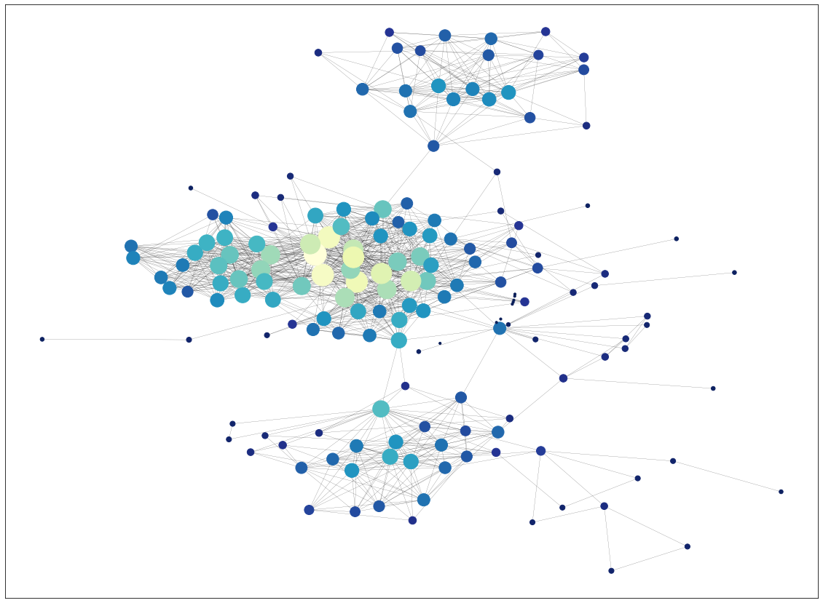
Social network analysis
Irina Govorova
мНОД-2020

Slide 2
Network summary
Number of nodes: 167
Number of edges: 1100
Number of connected components: 10
Radius: 5
Diameter: 9
Average clustering coefficient: 0.56
Average path length (largest cc): 3.49

Slide 3
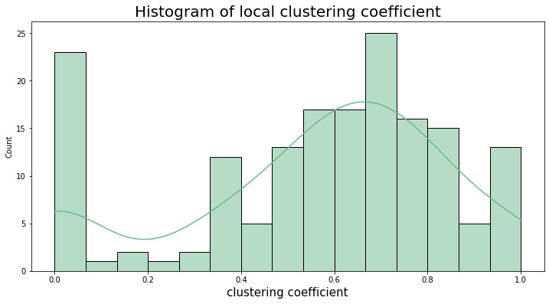
Histograms
Majority of nodes have high clustering coefficients, so they to tends to cluster.
But there are many nodes with 0 clustering coefficient and that reduce average value to 0.56

Slide 4
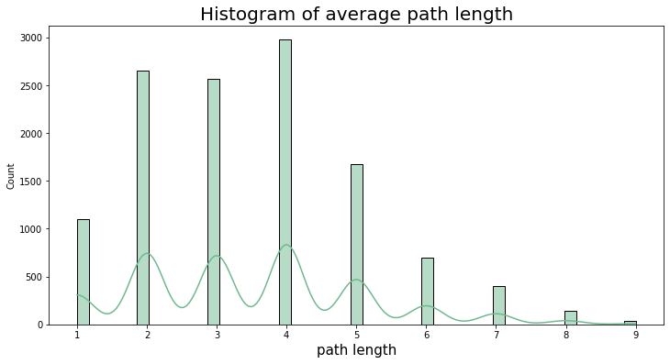
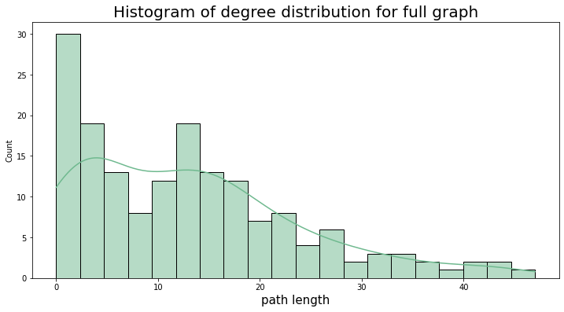
Histograms

Slide 5
Network layout

Slide 6
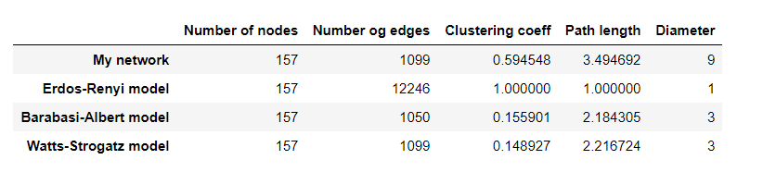
Random network models
The closet random model is Watts-Strogatz model. It has the same number of edges, closest average path length and diameter.

Slide 7
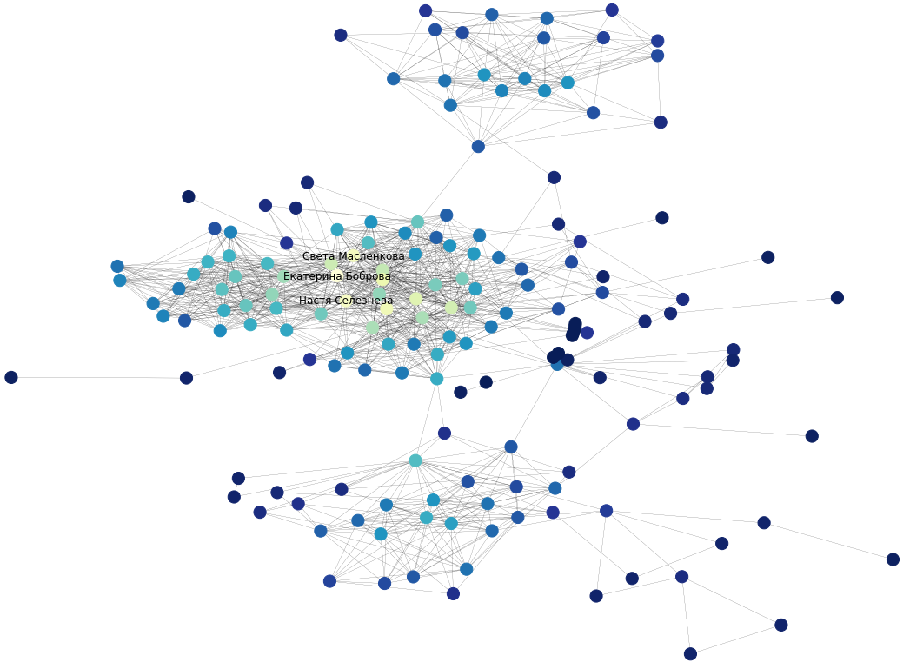
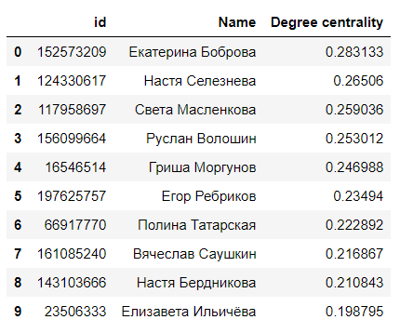
Degree centrality
Top-10 nodes

Slide 8
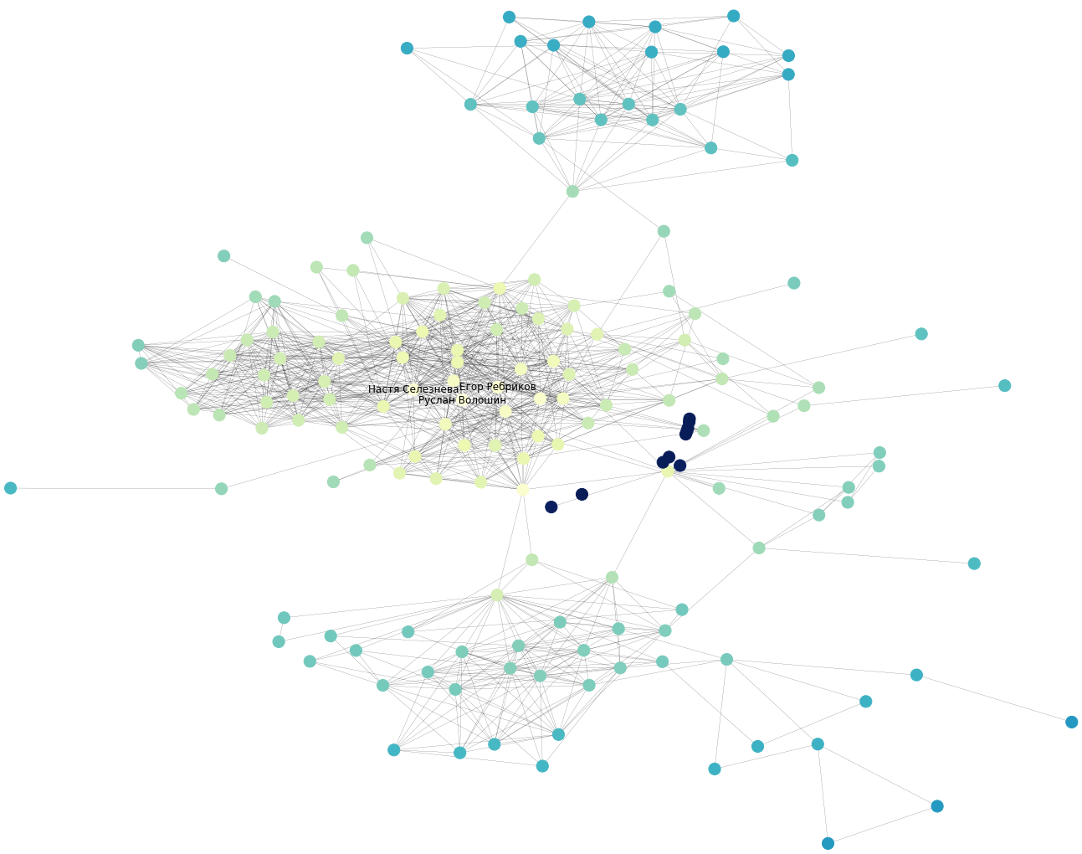
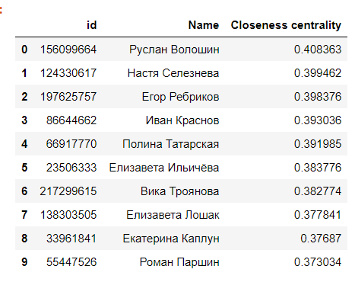
Closeness centrality
Top-10 nodes

Slide 9
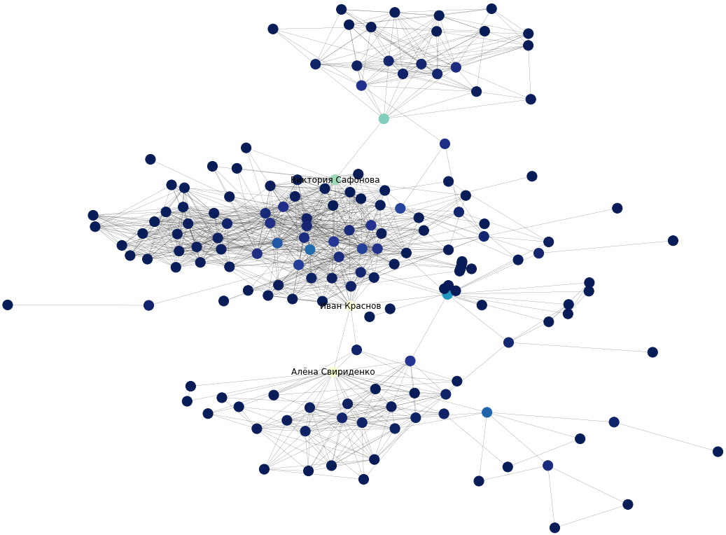
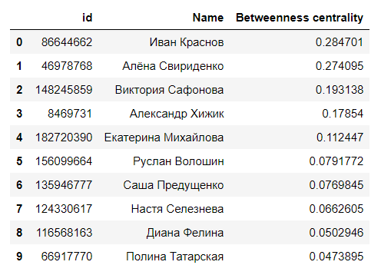
Betweenness centrality
Top-10 nodes

Slide 10
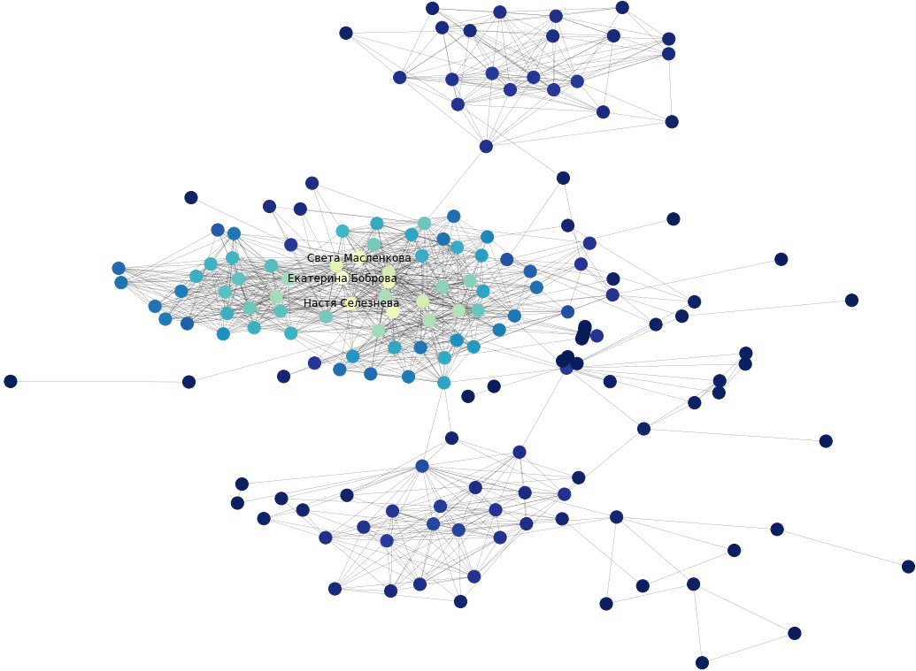
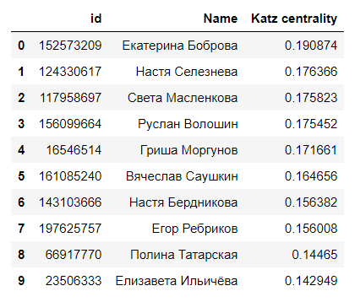
Katz centrality
Top-10 nodes

Slide 11
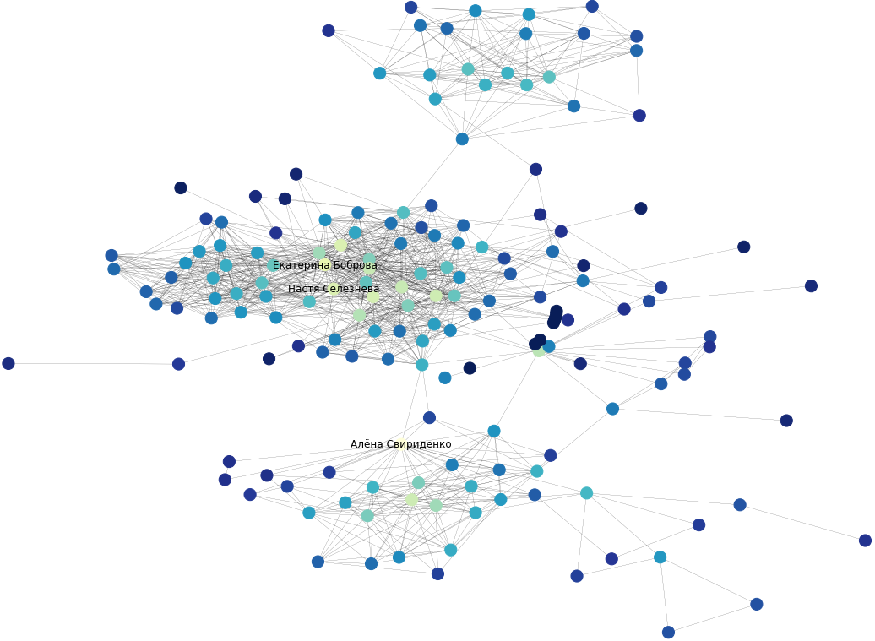
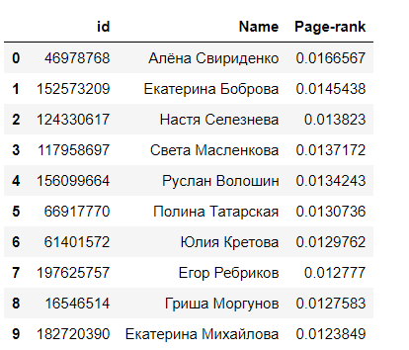
Page-Rank
Top-10 nodes

Slide 12
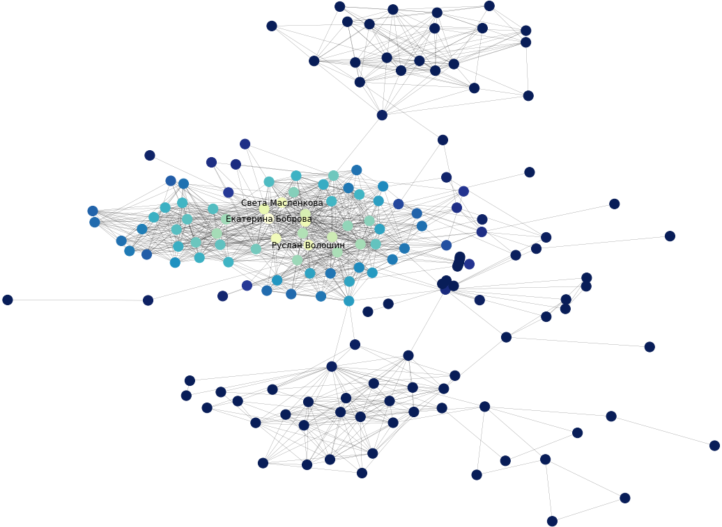
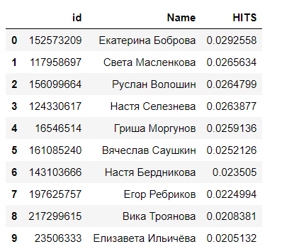
HITS
Top-10 nodes

Slide 13
Correlation comparison
Pearson correlation coefficient
Page-Rank
HITS
Degree centrality: 0.87
Closeness centrality: 0.53
Betweenness centrality: 0.44
Katz centrality: 0.7
Degree centrality: 0.88
Closeness centrality: 0.67
Betweenness centrality: 0.16
Katz centrality: 0.99
Page-Rank is mostly correlated with degree centrality and they have quite similar top-10 nodes
HITS is almost linearly dependent on Katz centrality and they have almost equivalent top-10 nodes.

Slide 14

Assortativity
My graph is non-assortative by sex attribute but tends to be assortative by city and education attributes. Not everyone specify city and university in their VK profiles. So I think my graph could be more assortative by city and education if there was no missing attributes

Slide 15
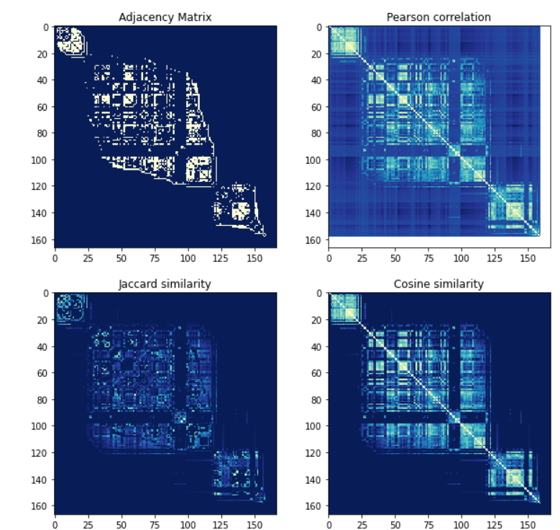
Node structural similarity
My graph has a lot of structurally similar nodes. That is why my friends are well separated into communities, which do not intersect and majority of friends from one community know each other

Slide 16
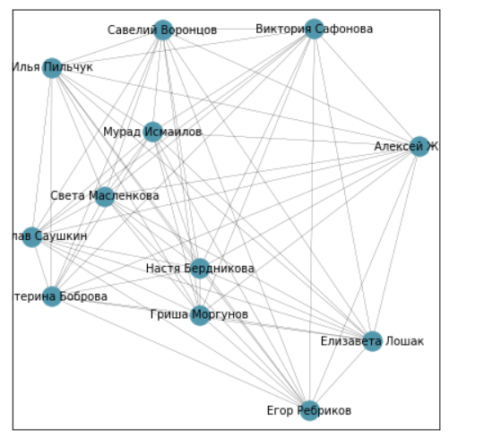
Clique search
Number of cliques: 509
Number of cliques of maximal size: 10
Maximal size: 12
All cliques of maximal size are networks of my groupmates from RUDN

Slide 17
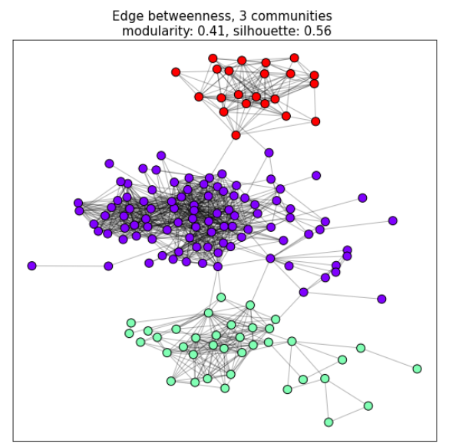
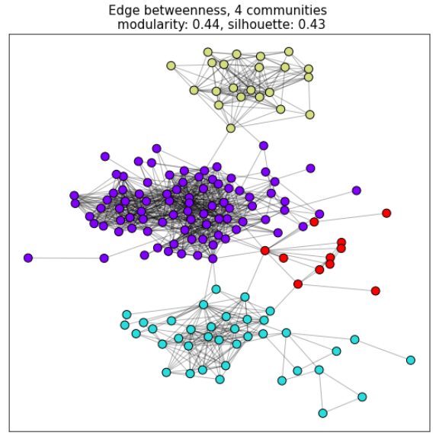
Communities
HSE
HSE
RUDN, Engineering academy
RUDN
RUDN, Law Faculty
Lipetsk
Lipetsk

Slide 18
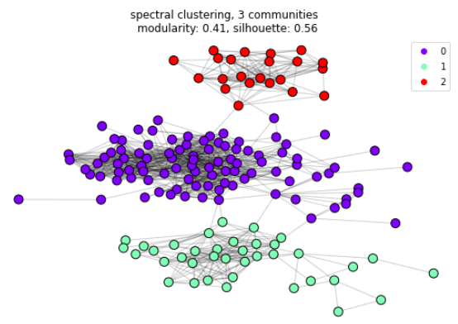
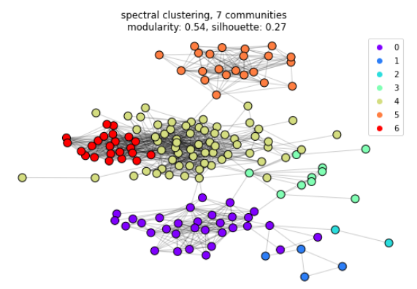
Communities
HSE
RUDN, Engineering academy
HSE
RUDN
RUDN, ICT
RUDN, Law Institute
Music school spec. lessons
Lipetsk
Lipetsk
Music school chorus lessons

Slide 19
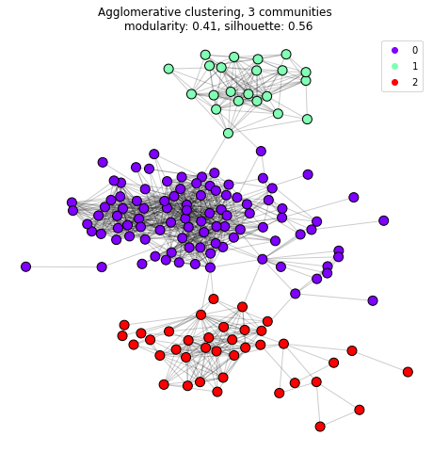
Communities
HSE
RUDN
Lipetsk

Slide 20
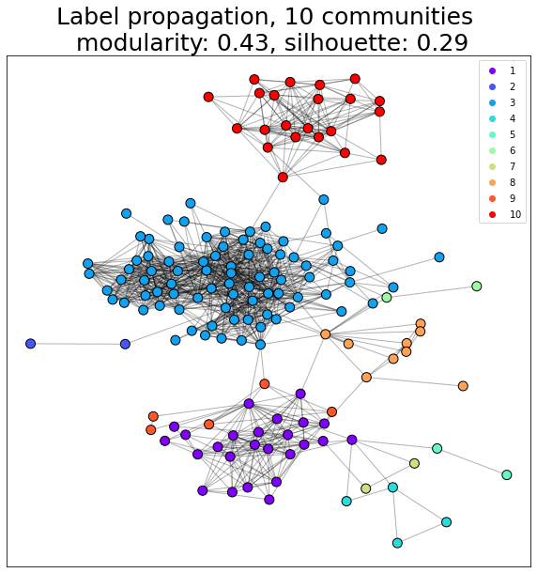
Communities
HSE
RUDN, Engineering academy
RUDN student dormitory
RUDN, Law Institute
RUDN, HBaTI
Lipetsk, dance team
Music school spec. lessons
Another group from music school spec. lessons
Lipetsk, my school
Music school chorus lessons

Slide 21
Thank you for attention!

